Slide 1
Speaker Knowledge Influences the Comprehension of Pragmatic Inferences (Bergen & Grodner, 2012)
Disha Dasgupta

Slide 2
Objective
To determine how, and at what point in interpretation, speaker knowledge affects the comprehension of scalar implicatures
Scalar Implicature: an implicit meaning beyond the explicit/literal meaning of a sentence

Slide 3
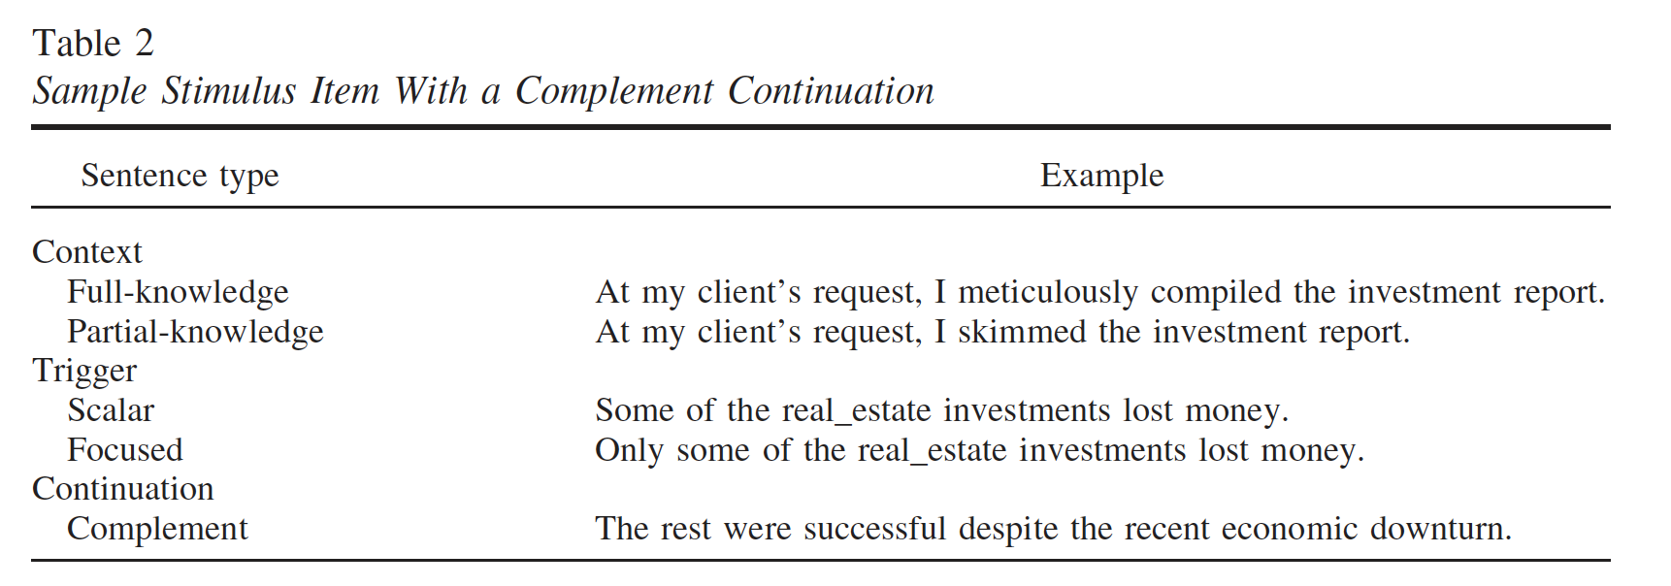
Summary
42 participants were given 24 stimulus passages consisting of Context, Trigger, and Continuation sentences
Sentences presented in self-paced word-by-word display
Recorded:
Time between button presses
Follow-up comprehension question accuracy
20 extra participants for partial-knowledge to address speaker knowledge

Slide 4
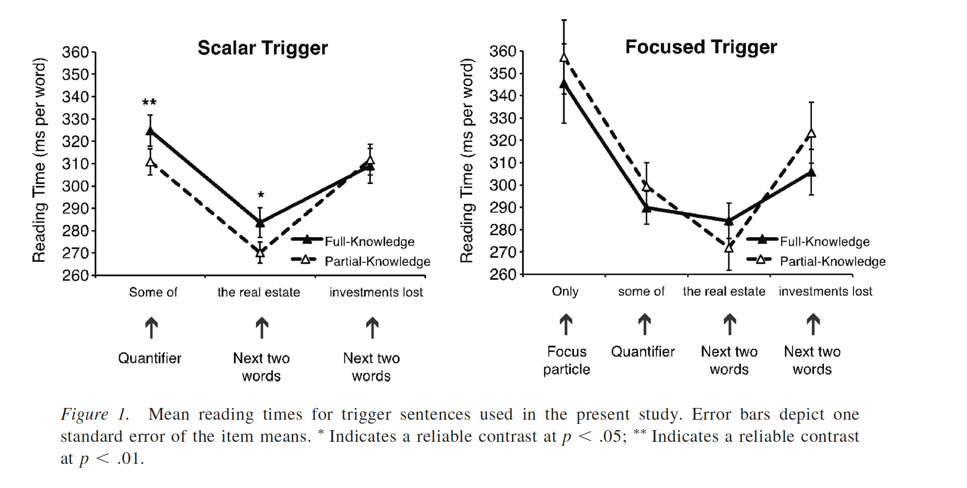
Plan for Replication
Use experimental materials (stimuli and comprehension questions) provided by original researchers
Create word-by-word setup using self_paced_reading template
Reading time visualizations/analysis and comprehension question analysis

Slide 5
Potential Challenges
Limits for participants?
Age, geographical location, etc.
Integrating 20 additional participants into analysis
Unclear on analysis methods

